Slide 1
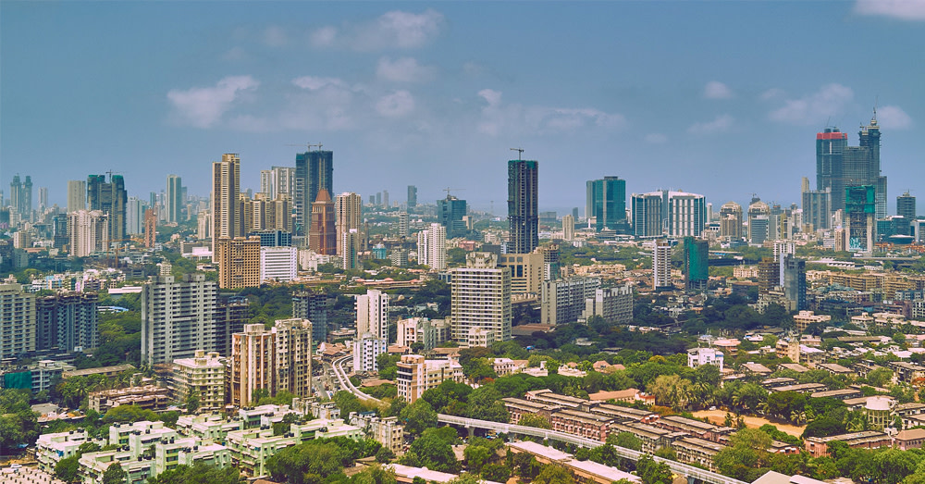
Explore Zomato restaurants dataset in the city of New Delhi

Slide 2
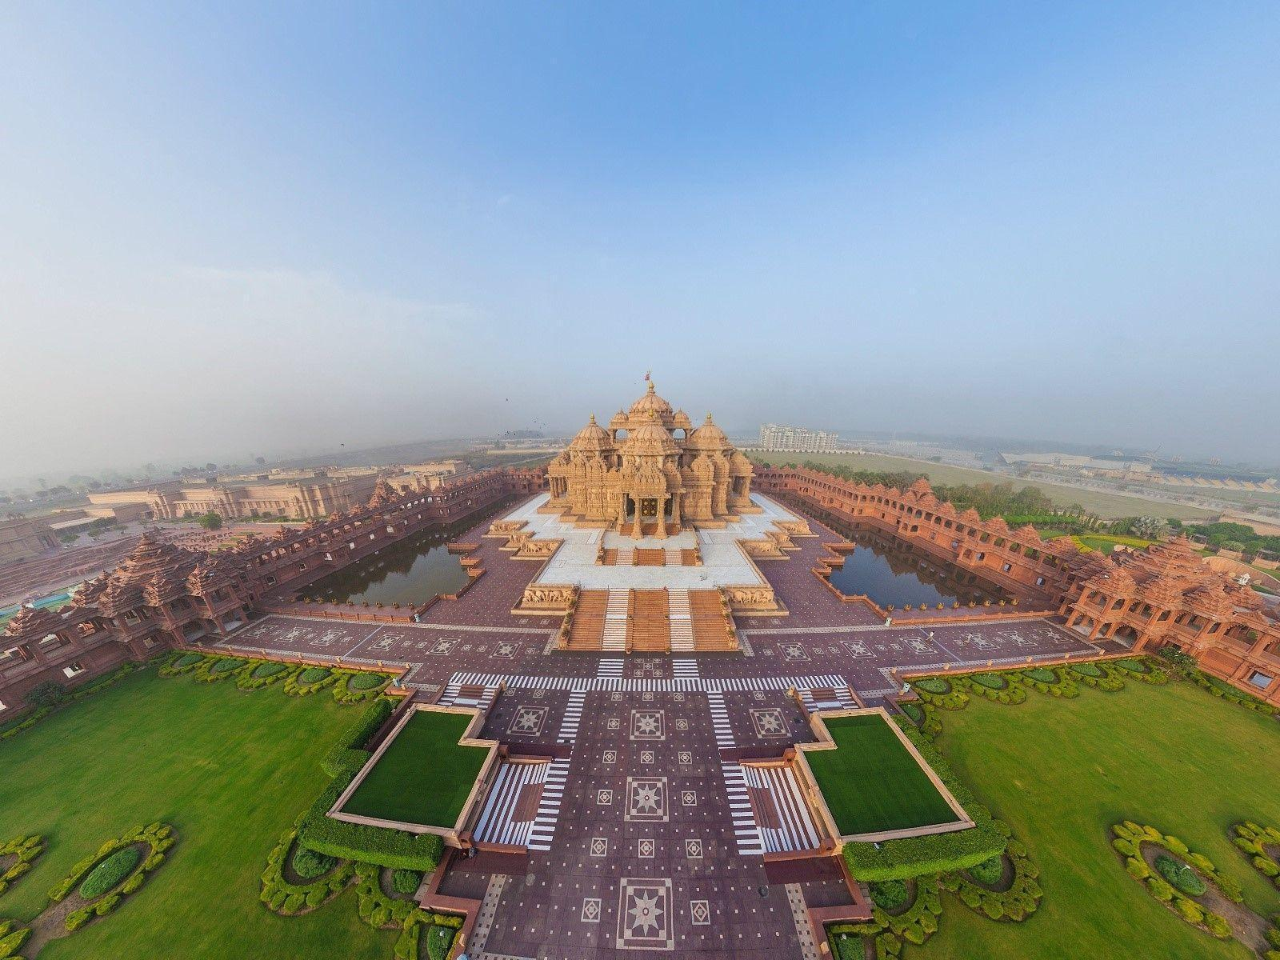
Introduction
Capstone Project — The Battle of Neighbourhoods
Introduction
Living in New Delhi since past 5 years i have explored it very well and love eating food so as we know New Delhi is the capital city of India. The city itself has a population of lacs. However, the much larger metro area has a population that exceeds 26 million.
Over last decades it is continuously growing because of the city’s important role in government and commercial business.
With its diverse culture , comes diverse food items. There are many restaurants in New Delhi City, each belonging to different categories like Chinese , Italian , French etc. So as part of this project , we will list and visualise all major parts of New Delhi City .

Slide 3

objective
Questions that can be asked using the above-mentioned datasets
1.What is best location in New Delhi City for Chinese Cuisine ?
2.Which areas have large number of Chinese Restaurant Market ?
3.Which all areas have a smaller number of restaurant ?
4.Which is the best place to stay if I prefer Chinese Cuisine ?
5.What places are having best restaurant in New Delhi?

Slide 4
DATA
For this project we need the following data :
New Delhi Restaurants data that contains list Locality, Restaurant name, Rating along with their latitude and longitude.
Data source : Zomato Kaggle dataset
Description : This data set contains the required information. And we will use this data set to explore various locality of new Delhi city.
Nearby places in each locality of new Delhi city.
Data source : Foursquare API
Description : By using this api we will get all the venues in each neighborhood.

Slide 5
APPROACH
Collect the new delhi city data from Zomato kaggel dataset. Using FourSquare API we will find all venues for each neighborhood. Filter out all venues that are nearby by locality. Using aggregative rating for each resturant to find the best places. Visualize the Ranking of neighborhoods using folium library(python).

Slide 6
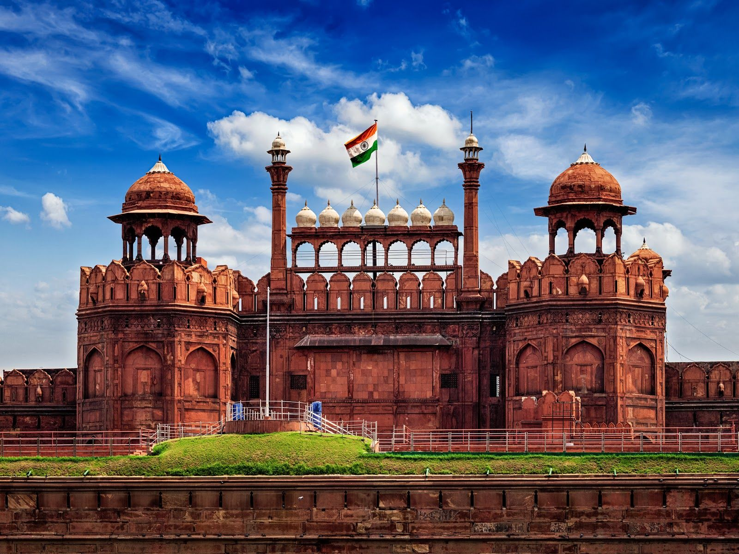
RESULTS

Slide 7
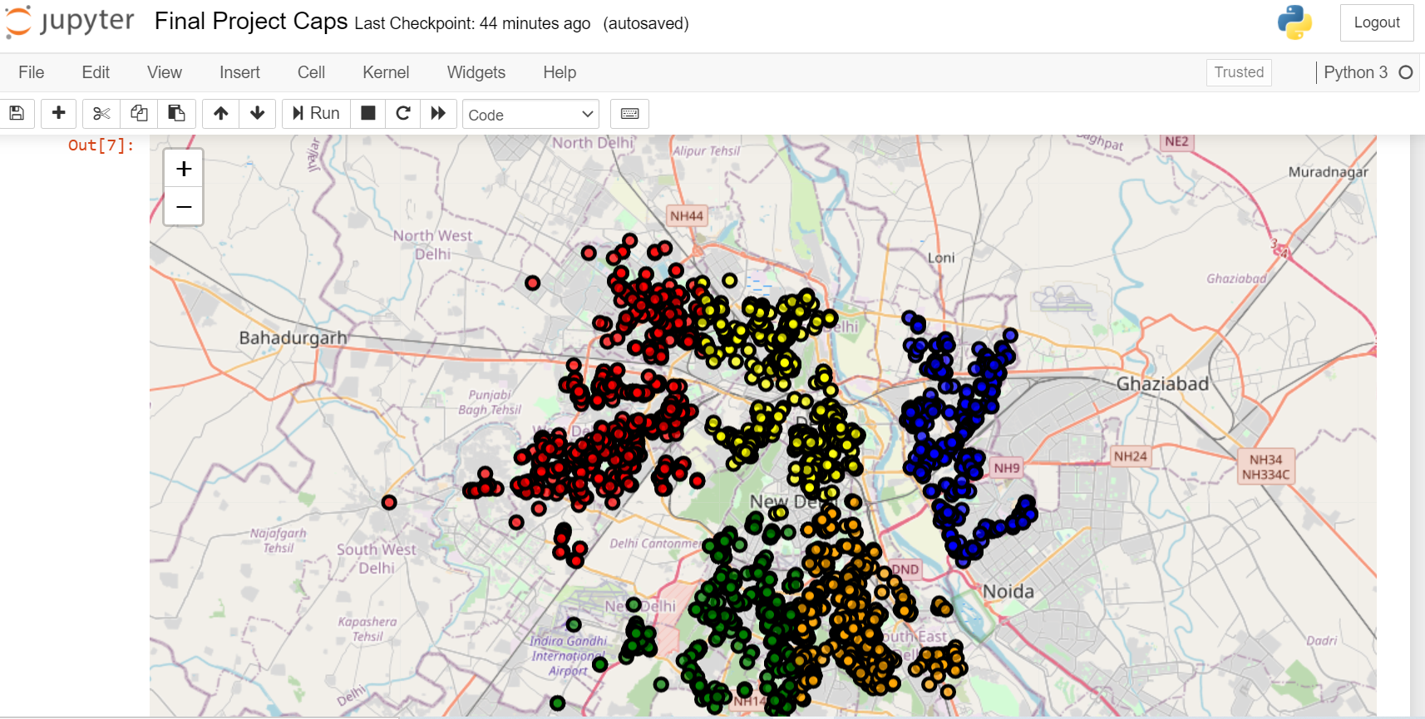
Map of Delhi with restaurant clutter

Slide 8
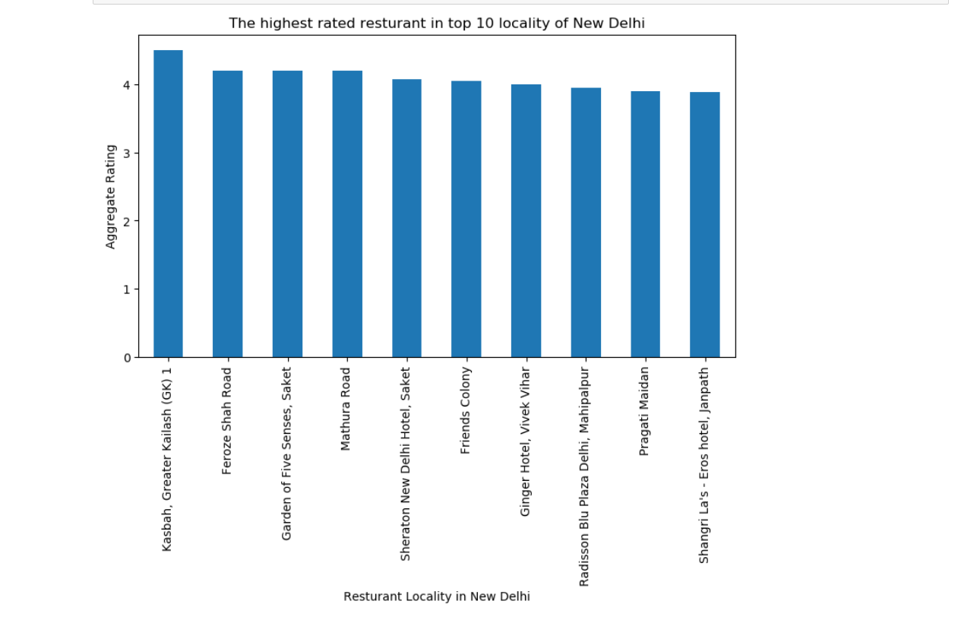
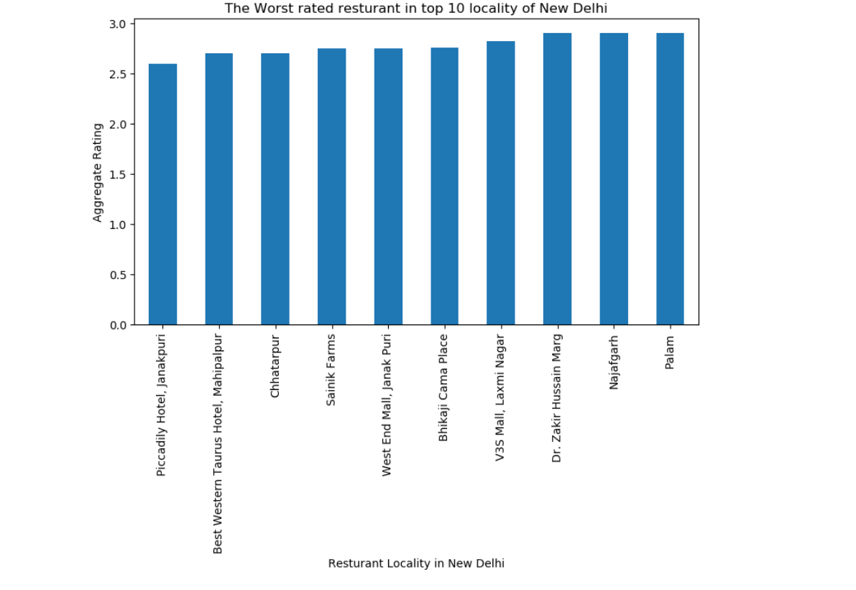
Highest rated and worst rated restaurants

Slide 9
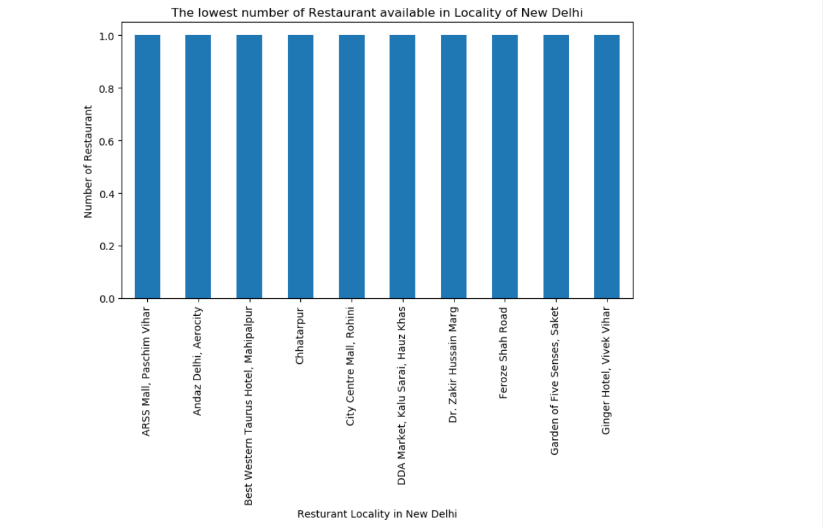
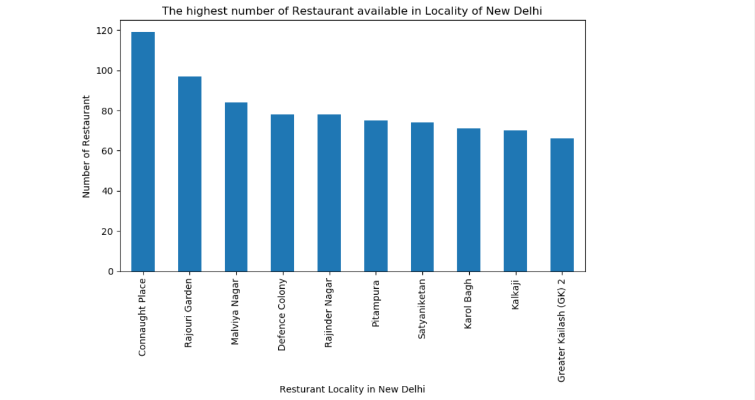
Highest number and worst number of restaurants

Slide 10
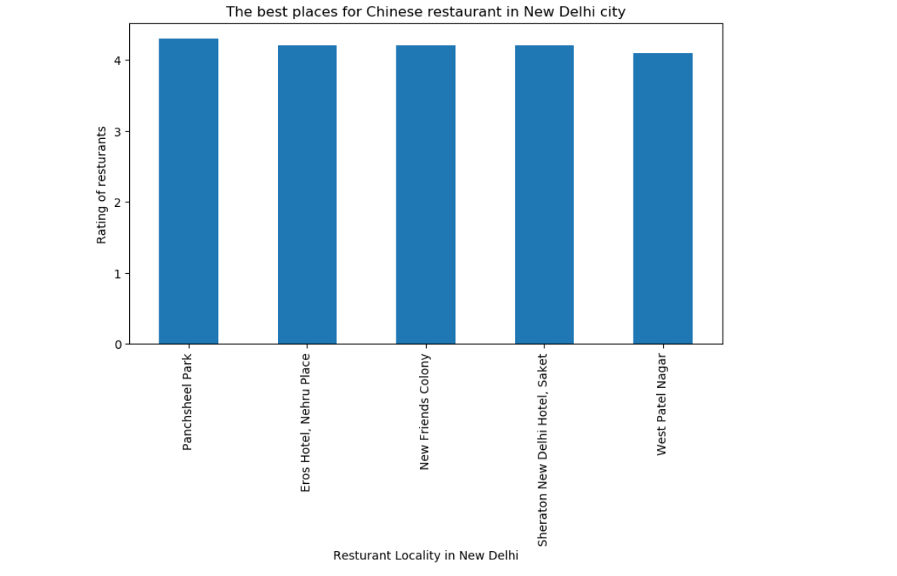
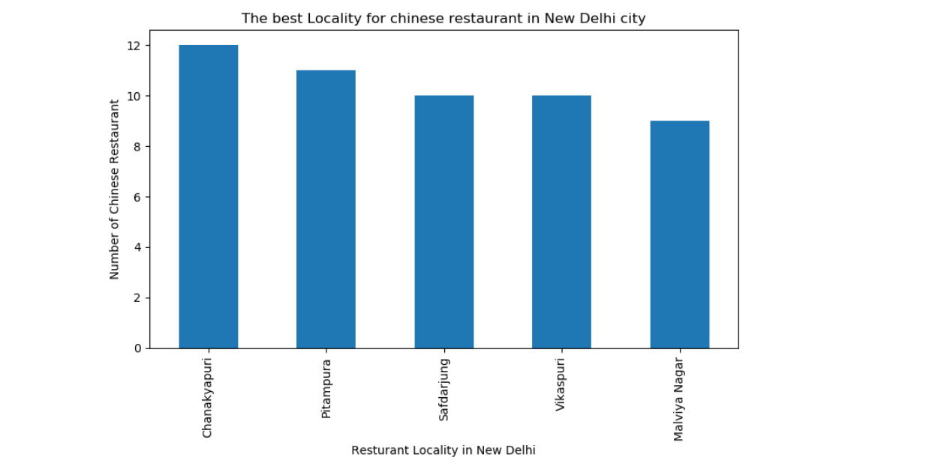
Best locality and places of restaurants

Slide 11
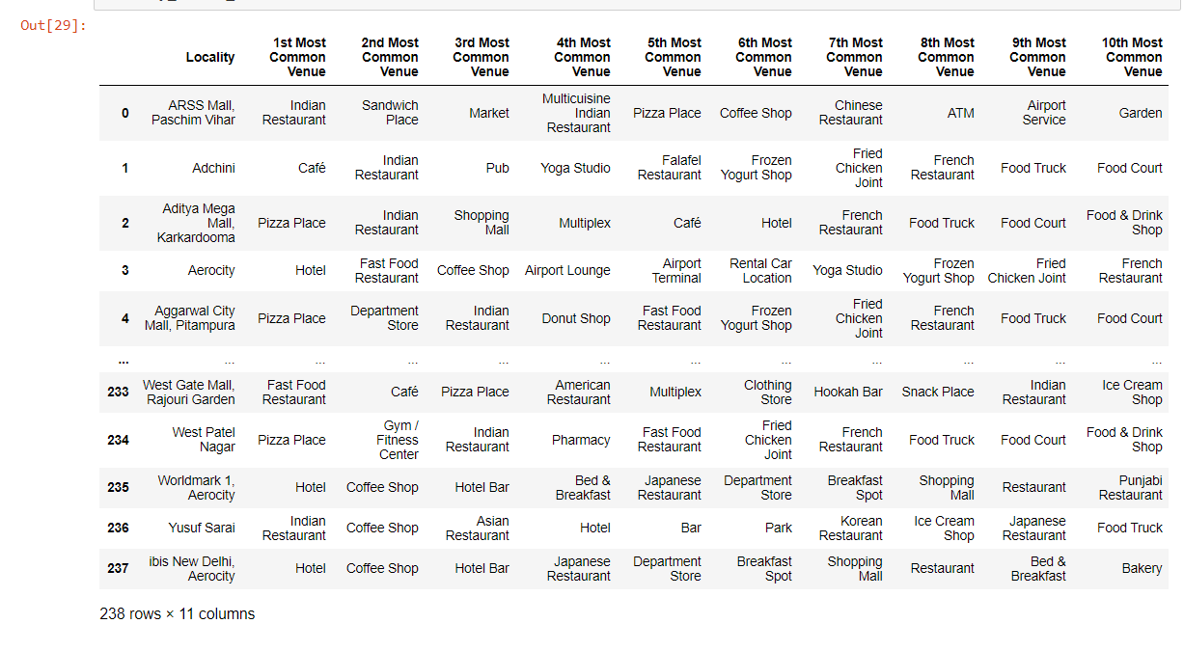

Slide 12
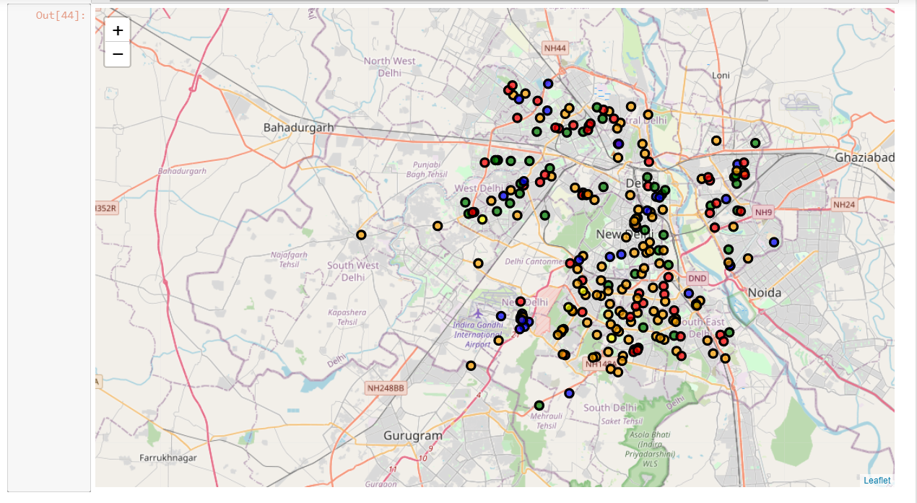
5 Clusters of restaurants

Slide 13
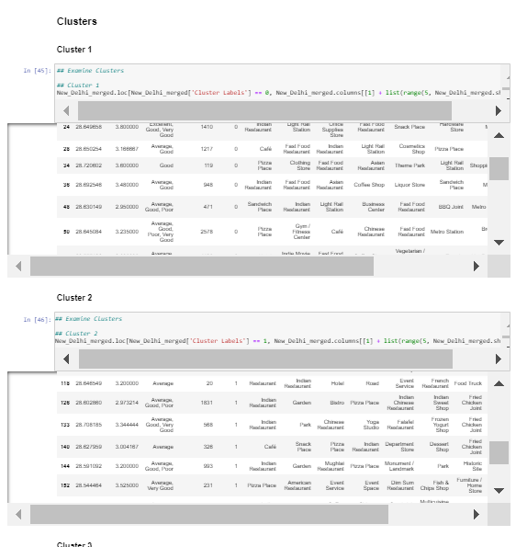

Slide 14
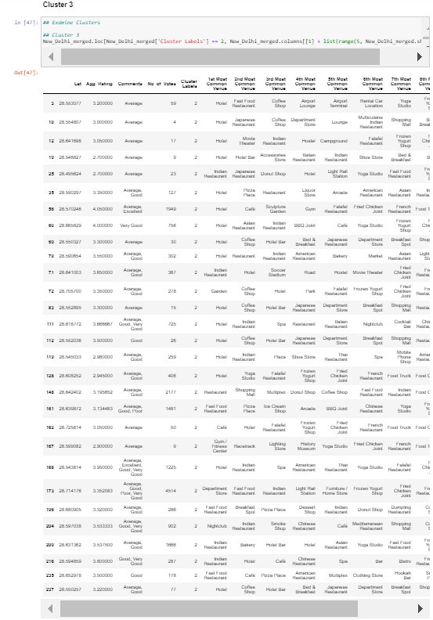

Slide 15
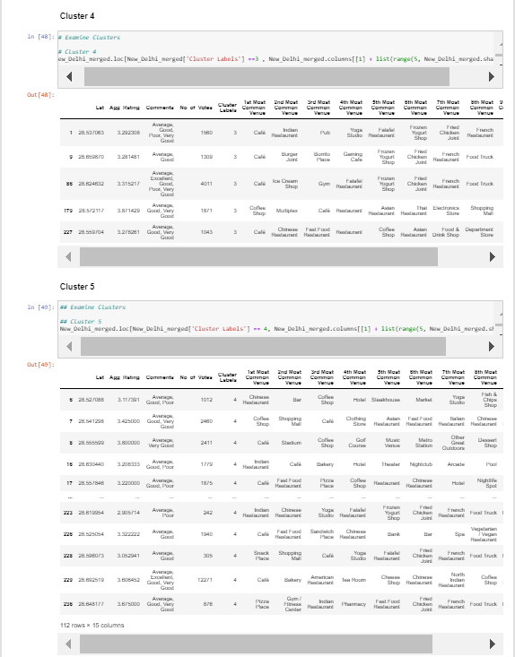

Slide 16
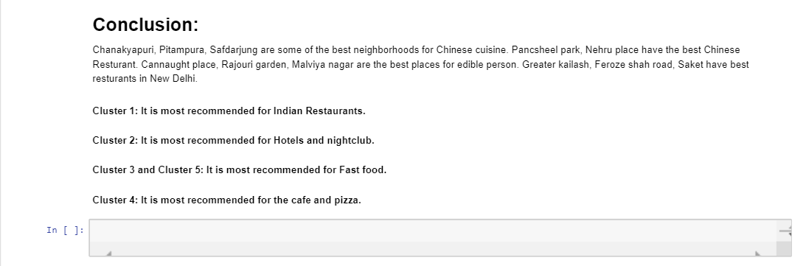
Conclusion

